Slide 1
Introducing Spring Batch
A Quickstart guide to offline processing with Spring Batch

Slide 2
Topics in this Session
Batch and offline processing
Spring Batch high-level overview
Job parameters and job identity
Quick start using Spring Batch
Common Patterns and practices
Reading flat files

Slide 3
Topics in this Session
Batch and offline processing
Spring Batch high-level overview
Job parameters and job identity
Quick start using Spring Batch
Common Patterns and practices
Reading flat files

Slide 4
Batch and offline processing
Close of business processing
  Order processing
  Business reporting
  Account reconciliation
Import/export handling
  Instrument/position import
  Data warehouse synchronization
Large-scale output jobs
  Loyalty scheme emails
  Bank statements

Slide 5
Batch Domain
The batch domain adds some value to a plain business process by introducing new concepts:
  A job has an identity – not just a stream of bytes
  A job has steps
  A job can be restarted after a failure – a new execution
  Each execution has a start time, stop time, status
  The job has an overall status
  Each execution can tell us how many items were processed, how many commits, rollbacks, skips
Add value through robustness, reliability, traceability (SLA)

Slide 6
Topics in this Session
Batch and offline processing
Spring Batch high-level overview
Job parameters and job identity
Quick start using Spring Batch
Common Patterns and practices
Reading flat files

Slide 7
Spring Batch Overview
The Spring programming model applied to batch processing
Don’t write code that doesn’t make you money
Download http://www.springframework.org/spring-batch

Slide 8
Job and Step
Job
The EndOfDay Job
*
Sequence of steps, e.g. Copy data, send e-mail, clean up
Step

Slide 9
Item-Oriented Processing
Input-output can be grouped together = Item-Oriented Processing
Step
ItemReader
ItemWriter
execute()
read()
repeat, retry, etc.
item
Delegate business logic
write(item)
ExitStatus

Slide 10
JobLauncher
Client
JobLauncher
Job
Business
start()
execute()
ExitStatus
JobExecution
With ExitStatus.FINISHED or FAILED

Slide 11
Topics in this Session
Batch and offline processing
Spring Batch high-level overview
Job parameters and job identity
Quick start using Spring Batch
Common Patterns and practices
Reading flat files

Slide 12
Job Identity
When you launch a job, what is it that you launch?
If it fails how would you identify it?
How can we track the eventual successful execution?

Slide 13
Job Identity and Parameters
The EndOfDay Job
Job
schedule.date = 2007/05/05
JobParameters
*
The EndOfDay Job
for 2007/05/05
JobInstance
*
The first attempt at
EndOfDay Job
for 2007/05/05
JobExecution

Slide 14
Job Persistence
Need to track status of job executions
Readers and writers are often stateful, so need to persist e.g. intermediate state
Batch meta-data stored in
  Relational database
  Volatile (map)
Core interface = JobRepository

Slide 15
JobLauncher and JobRepository
run
1
JobLauncher
createJobExecution
2
JobRepository
execute
3
Job

Slide 16
JobRepository Practicalities
JobRepository is really an internal interface (no need for users to know details)
Users do, however, need to create instances of JobRepository
Framework provides factory beans
E.g. for relational database types: oracle, sybase, mysql, db2, postgres, etc.

Slide 17
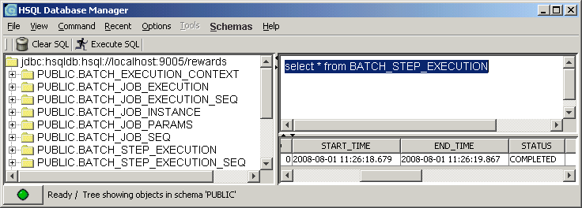
Batch Meta-Data Schema

Slide 18
Extended Picture: Job and Step
Step
Job
*
JobParameters
*
*
JobInstance
*
StepExecution
*
JobExecution

Slide 19
JobRepository and Batch Meta-Data
JobRepositoryFactoryBean
creates
Database
JobRepository
JobInstance
Batch Meta-Data
*
*
JobExecution
StepExecution

Slide 20
Topics in this Session
Batch and offline processing
Spring Batch high-level overview
Job parameters and job identity
Quick start using Spring Batch
Common Patterns and practices
Reading flat files

Slide 21
Spring Batch Quickstart
Configure the readers and writers
Configure a Job
Configure a JobLauncher
Load and run the job
  Write a wrapper for the JobLauncher
  Use an off-the-shelf wrapper CommandLineJobRunner
See the result in the return value from the JobLauncher

Slide 22
Configure JobLauncher
<beans>
<bean id=“jobLauncher” class=“org.sfw..SimpleJobLauncher”>
<property name=“jobRepository” ref=“jobRepository” />
</bean>
<bean id=“jobRepository” class=“org.sfw..JobRepositoryFactoryBean”>
<property name=“dataBaseType” value=“oracle” />
<property name=“transactionManager” ref=“transactionManager” />
<property name=“dataSource” ref=“dataSource” />
</bean>
</beans>

Slide 23
Configure Reader and Writer
<beans>
<bean id=“itemReader” class=“org.sfw..FlatFileItemReader”>
<property name=“fieldSetMapper”ref=“customMapper” />
<property name=“resource” value=“file://home/jobs/data/input.csv”/>
...
</bean>
<bean id=“itemWriter” class=“org.sfw..FlatFileItemWriter”>
<property name=“fieldSetCreator”ref=“customCreator” />
...
</bean>
</beans>

Slide 24
Configure a Job
<beans>
<bean id=“endOfDayJob” class=“org.sfw..SimpleJob”>
<property name=“steps”>
<bean id=“copyStep” class=“org.sfw..SimpleStepFactoryBean.”>
<property name=“itemReader” ref=“itemReader” />
<property name=“itemWriter” ref=“itemWriter” />
<property name=“jobRepository” ref=“jobRepository” />
<property name=“transactionManager” ref=“transactionManager” />
</bean>
</property>
...
</bean>
</beans>
Shared with job repository

Slide 25
Launch the Job
// Create the application from the configuration
ApplicationContext context =
new ClassPathXmlApplicationContext(“application-config.xml”);
// Look up the job launcher and job
jobLauncher = (JobLauncher) context.getBean(“jobLauncher”);
job = (Job) context.getBean(“endOfDayJob”);
// Launch the job
JobExecution execution =
jobLauncher.run(job, new JobParameters());
Use this to see the exit status

Slide 26
CommandLineJobRunner
Framework-provided command line utility
2 mandatory parameters: XML config location and job id
# Command line prompt:
$ java -classpath ... org.sfw...CommandLineJobRunner
application-config.xml endOfDayJob
(All on the same line)

Slide 27
Adding Parameters
With JobLauncher
JobParametersBuilder builder = new JobParametersBuilder();
builder.addString(“file.locator”, “2008-05-05”);
...
JobExecution execution =
jobLauncher.run(job, builder.toJobParameters());

Slide 28
Adding Parameters
With CommandLineJobRunner
$ java -classpath ... org.sfw...CommandLineJobRunner
application-config.xml endOfDayJob
run.id=1003AHQ7
schedule.date(date)=2008/05/05
key(type)=value pairs at end of line
where type = string | date | long

Slide 29
Topics in this Session
Batch and offline processing
Spring Batch high-level overview
Job parameters and job identity
Quick start using Spring Batch
Common Patterns and practices
Reading flat files

Slide 30
Readers and Writers
Spring Batch provides many implementations of ItemReader and ItemWriter, e.g.
  Flat files
  XML
  JDBC: cursor & driving query
  Hibernate
Some simple jobs can be implemented with off-the-shelf components

Slide 31
Simple Copy Job
Step
File
Database
ItemWriter
ItemReader

Slide 32
More Complex Use Cases
More complex jobs often require custom readers or writers
It is very common to use an off-the-shelf reader and writer
A custom writer is often a delegate to existing business logic

Slide 33
ItemReader
The interface is parameterised, so e.g.
public class DiningItemReader implements ItemReader<Dining> {
public Dining read() {
// Read a Dining record from somewhere...
return dining;
}
…
}

Slide 34
ItemWriter
Also parameterised:
public class DiningItemWriter implements ItemWriter<Dining> {
public void write(Dining dining) {
// Business logic here and write out to e.g. database
}
…
}

Slide 35
Business Delegation
Step
File
Database
ItemWriter
ItemReader
Application Context
Service
Repository
Repository
Repository
Infrastructure

Slide 36
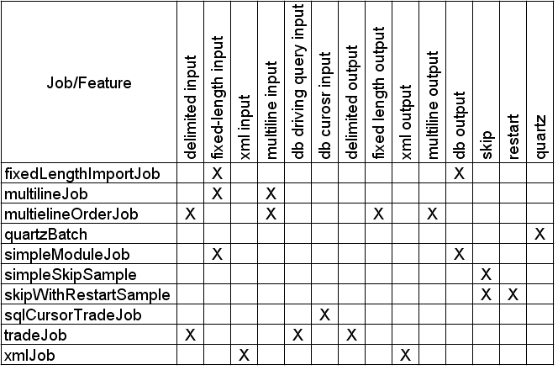
Sample Jobs

Slide 37
Topics in this Session
Batch and offline processing
Spring Batch high-level overview
Job parameters and job identity
Quick start using Spring Batch
Common Patterns and practices
Reading flat files

Slide 38
FlatFileItemReader
Delegates to LineTokenizer and FieldSetMapper
FlatFileItemReader
LineTokenizer
FieldSetMapper
read()
tokenize(line)
fieldSet
Business knowledge here
mapLine(fieldSet, lineNum)
item
item

Slide 39
FieldSet
Intermediate between line (record) in file and domain object
Immutable wrapper for array of Strings
Access fields by name or index, and by type
FieldSet fs = ... ;
Date date = fs.readDate(0, “dd/MM/yyyy”); // first field
Long number = fs.readLong(1); // second field
String value = fs.readString(“city”); // named field
String[] values = fs.getValues(); // all fields

Slide 40
FieldSetMapper
Maps a FieldSet to a domain Object
public class DiningFieldSetMapper
implements FieldSetMapper<Dining> {
public Dining mapLine(FieldSet fs) {
// Construct and and return a Dining object
}
}

Slide 41
FieldSetMappers in Spring Batch
Spring Batch provides a couple of mappers for common use cases...
PassthroughFieldSetMapper
  returns the FieldSet
  simple use cases with no domain model, e.g. copy straight from file to database
BeanWrapperFieldSetMapper
  uses field names to bind to a prototype object
  Binds using Spring TypeConverter (a.k.a. PropertyEditor) support

Slide 42
Lab
Loading a delimited file into a database

